Slide 1

Chapter 10
Managing for Sustainability

Slide 2

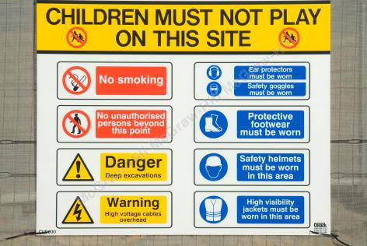
Role of Government
In many nations government regulates business activity in order to protect the environment.
Major Areas of Environmental Regulation
10-2
Notes:
Role of Government
In many nations government regulates business activity in order to protect the environment.
By setting common standards, governments can take cost of pollution control out of competition.
Governments can also provide economic incentives and offer systems for resolving disputes.
Major Areas of Environmental Regulation
Environmental Protection Agency (EPA), main agency charged with pollution control, was established in 1970.
In the United States, the federal government regulates in three major areas of environmental protection:
Air pollution.
Water pollution.
Solid and hazardous waste.

Slide 3
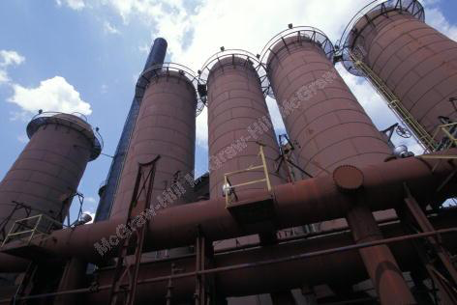
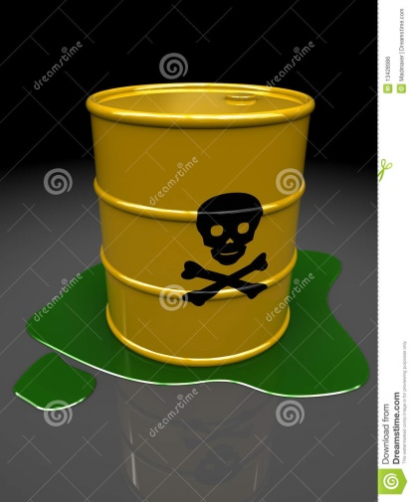
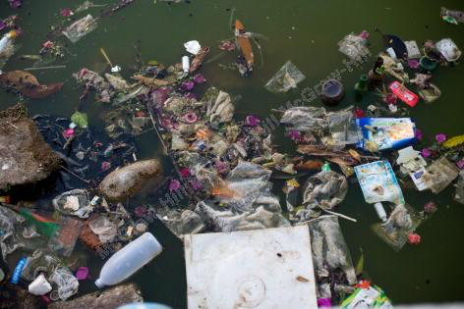
Three Major Areas of
Environmental Regulation1
Air pollution
Water pollution
Solid and Hazardous Waste
10-3
Notes:
Air pollution
Occurs when more pollutants are emitted into the atmosphere than can safely be absorbed and diluted by natural processes.
Results from human activity, especially industrial processes and motor vehicle emissions.
The major law governing air pollution is the Clean Air Act.
→ Example: Volkswagen violated the Clean Air Act when it programmed emissions control devices on some of its diesel cars so that they polluted more than the law permitted.
Water pollution
Occurs when more wastes are dumped into waterways than can be naturally diluted and carried away.
Failure to comply with clean water laws can be very expensive for business.
The main U.S. law governing water pollution is the Water Pollution Control Act, also known as the Clean Water Act.
Goal is to restore or maintain the integrity of all surface water in the United States.
Solid and Hazardous Waste
The contamination of land by both solid and hazardous waste.
Environmental justice: The effort to prevent inequitable exposure to risk, such as from hazardous waste, in disadvantaged communities.
Superfund or CERCLA legislation passed in 1980
Established fund to clean up the most dangerous toxic waste sites in the United States.

Slide 4


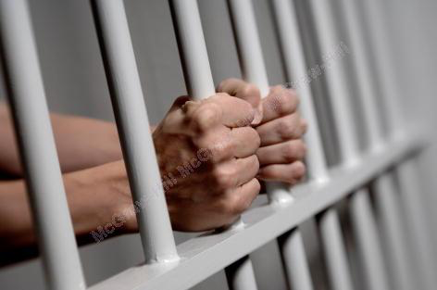

Alternative Policy Approaches1
Command and Control Regulation
Market-based mechanisms
Information disclosure
Civil and criminal enforcement
10-4
Notes:
Command and Control Regulation:
Government commands business to comply with certain standards and often controls their choice of technology, requiring the best available.
→ Example: Government sets the maximum amount of a pollutant a factory can emit.
Market-based mechanisms
Based on the idea that the market is a better control than extensive standards that specify precisely what companies must do.
Cap-and-trade: allows businesses to buy and sell the right to pollute, a process.
Example: California’s tradable permits.
Emissions charges or fees.
Example: green taxes or eco-taxes.
Government incentives.
Information disclosure
Also called regulation by publicity or regulation by embarrassment.
The government encourages companies to pollute less by publishing information about the amount of pollutants individual companies emit each year.
Civil and criminal enforcement
The threat of fines or even prison can be an effective deterrent to corporate outlaws who would otherwise degrade the environment.
Example: Anadarko Petroleum paid more than $5 billion to settle charges of environmental contamination and to pay for cleanup.
European regulators have actively pursued environmental criminals.
U.S. Sentencing Commission has established guidelines for sentencing environmental wrongdoers.

Slide 5
Advantages and Disadvantages of
Alternative Policy Approaches to Reducing Pollution1
From Figure 10.2
Copyright © McGraw-Hill Education. Permission required for reproduction or display.
Policy Approach | Advantages | Disadvantages
Command-and-control regulation | Enforceable in the courts Compliance mandatory | Across-the-board standards not equally relevant to all businesses. Requires large regulatory apparatus. Older, less-efficient plants may be forced to close Can retard innovation. Fines may be cheaper than compliance. Does not improve compliance once compliance is achieved.
10-5

Slide 6
Advantages and Disadvantages of
Alternative Policy Approaches to Reducing Pollution2
Copyright © McGraw-Hill Education. Permission required for reproduction or display.
From Figure 10.2
Market-based mechanisms | Advantages | Disadvantages
Cap-and-trade systems | Gives businesses more flexibility. Achieves goals at lower overall cost. Saves jobs by allowing some less-efficient plants to stay open. Permits the government and private organizations to buy allowances to take them off the market. Encourages continued improvement. | Gives business a license to pollute. Permit levels are hard to set. May cause regional imbalances in pollution levels. Enforcement is difficult.
Emissions fees and taxes | Taxes bad behavior (pollution) rather than good behavior (profits). | Fees are hard to set. Taxes may be too low to curb pollution.
10-6

Slide 7
Advantages and Disadvantages of
Alternative Policy Approaches to Reducing Pollution3
From Figure 10.2
Copyright © McGraw-Hill Education. Permission required for reproduction or display.
Policy Type | Advantages | Disadvantages
Government incentives | Rewards environmentally responsible behavior. Encourages companies to exceed minimum standards. | Incentives may not be strong enough to curb pollution.
Information disclosure | Government spends little on enforcement. Companies able to reduce pollution in the most cost-effective way. | Does not motivate all companies.
Civil and criminal enforcement | Taxes bad behavior (pollution) rather than good behavior (profits). | May not deter wrongdoing if penalties and enforcement efforts are perceived as weak.
10-7

Slide 8
Costs and Benefits of
Environmental Regulation
From Figure 10.3
Copyright © McGraw-Hill Education. Permission required for reproduction or display.
Costs | Benefits
Manufacturers, mining companies, and utilities spend billions of dollars annually to comply with environmental regulations. | Emissions of pollutants drop
Some jobs are lost in particularly polluting industries. | Air and water quality improves; toxic-waste sites are cleaned up; and natural beauty is preserved or enhanced.
Competitiveness of some capital-intensive, “dirty” industries is impaired. | People live longer and healthier lives in less polluted environments.
Consumers pay more when companies pass along increased costs of regulations. | Jobs are created in the clean economy sector, such as environmental products and services, alternative energy, and tourism.
10-8
Notes:
Environmental regulations have led to the loss of jobs in some polluting industries, but at the same time have stimulated other sectors.
Clean Economy: Sectors of the economy that produce goods and services with an environmental benefit.
→ Example: Jobs have been created in:
Alternative energy.
Electric vehicles.
Energy-efficient construction.

Slide 9
Stages of Corporate
Environmental Responsibility
Clean technology
Businesses develop innovative, new technologies that support sustainability
Product stewardship
Managers focus on all environmental impacts associated with the full life-cycle of a product
Pollution prevention
Focuses on minimizing or eliminating waste before it is created
1
2
3
10-9
Notes:
Environmental regulations establish minimum standards for environmental performance.
Many firms are now voluntarily moving beyond compliance
to improve environmental performance in all operational areas.
to manage proactively for sustainability.

Slide 10

Effective Sustainability Management
Ecologically Sustainable Organization
Sustainability Management in Practice
Common characteristics:
  Top management commitment.
  Clear goals and metrics.
  Employee engagement.
  Alignment of rewards and incentives.
Notes:
Ecologically Sustainable Organization
Companies that operate consistently with principles of sustainable development.
Is an “ideal,” absolute standard against which real organizations can be measured.
Some visionary companies are trying to achieve this.
→ Example: Interface.
Supportive government policies and widespread movement among many businesses and other social institutions will be needed for ESOs to succeed.
Sustainability Management in Practice
An emerging role at many leading firms is the Chief Sustainability Officer (CSO).
Interpersonal skills—being able to work effectively with people across the organization—are critical to success.

Slide 11

Environmental Auditing and Reporting
Environmental Partnerships
10-11
Notes:
Environmental Auditing and Reporting
A way for leading companies to track their progress toward meeting sustainability goals.
More recently, many firms have moved to integrate their social and environmental reporting into a single sustainability report.
Integrated reporting occurs when companies report to stakeholders not just their financial results but also their environmental and social impacts.
Environmental Partnerships
Draw on the unique strengths of the different partners to improve environmental quality or conserve resources.
→ Example: Partnership between Starbucks Corporations and Conservation International (CI).

Slide 12

Sustainability Management as a Competitive Advantage1
Cost savings
Brand differentiation
Technological innovation
Reduction of regulatory and liability risk
Strategic planning
10-12
Notes:
Sustainability Management as a Competitive Advantage
Cost savings
Companies obtain significant cost savings by reducing pollution and hazardous waste, recycling materials, and operating with greater energy efficiency.
Brand differentiation
Companies that develop a reputation for environmental excellence distinguish their brand and attract like-minded customers.
Technological innovation
Technological innovation can lead to imaginative new methods for reducing pollution and increasing efficiency.
Reduction of regulatory and liability risk
Companies that are proactive with respect to their environmental impacts are often better positioned than their competitors to respond to new government mandates.
Strategic planning
Companies that cultivate a vision of sustainability must adopt sophisticated strategic planning techniques.

Slide 13
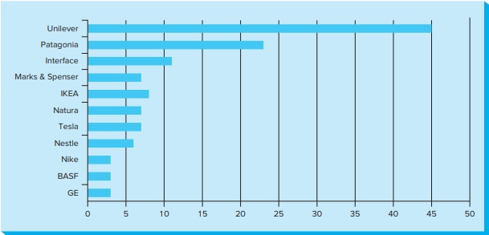
Corporate Leaders in Integrating Sustainability Into Their Business Strategy
Copyright © McGraw-Hill Education. Permission required for reproduction or display.
Figure 10.4
Access the text alternative for these images.
10-13

Slide 14
Chapter 10
Managing for Sustainability

